Slide 1
United Nations Development Programme
Promoting CSR in Albania
Global Compact and Corporate Social Responsibility Project
October 19, 2012

Slide 2
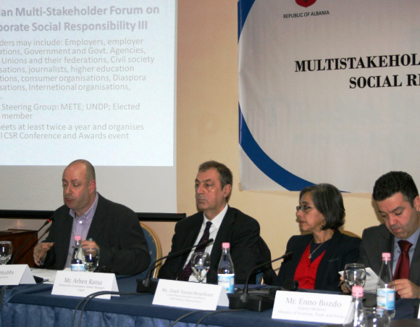
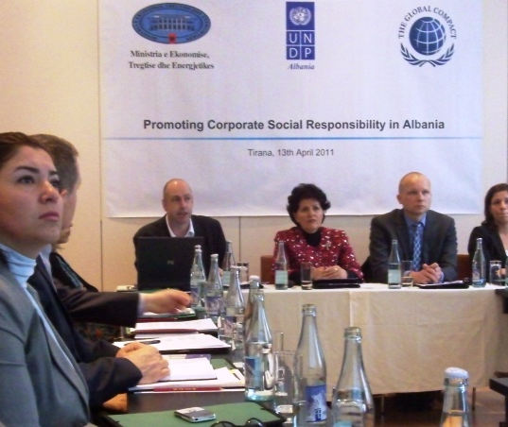
Global Compact in Albania
Starting from 2005 GC membership reached 36
Communication on progress
Thematic focus on Employment and Environment
Need for wider stakeholder engagement
CSR policy paper / National Action Plan on CSR

Slide 3
Government Role in CSR
Government in a leading role in the promotion of CSR in Albania
Department of Competitiveness within METE as co-ordinating body for CSR within the Government of Albania, responsible for the Action Plan of CSR
The Mission of the Government of Albania, through an ongoing, open and inclusive dialogue with all stakeholders, is to create the best possible enabling environment for the adoption of CSR practices in companies in Albania

Slide 4
National Action Plan on CSR
To raise awareness on CSR as key element of sustainable business;
To establish a national consensus on the measurement of CSR
To create an enabling environment in which there are clear, appropriate and meaningful incentives for the incorporation of CSR practices in business behavior;
To strengthen the adoption of CSR skills and competences throughout the business community;
To strengthen a culture of disclosure and support transparent, timely and accurate reporting by companies on their social and environmental impacts;
To reward excellence and progress in CSR amongst companies in Albania and in specific sectors.

Slide 5
Multi-stakeholder Forum on CSR
An advisory and consultative body which aims to:
raise awareness, spread knowledge and develop skills in all aspects of CSR through exchange of experience and good practice
promote the 10 principles of the Global Compact (human rights, labour standards, the environment, anti-corruption)
support efforts to create the best possible enabling environment for CSR in Albania
oversee the development of indicators for measuring CSR performance and the rewarding of best practice
explore the possibility of establishing a common, voluntary, Code of Business Conduct
comment on any other issues of concern to stakeholders

Slide 6
CSR activities during 2012 - 2013
Measuring CSR Performance:
Development of National CSR indicators
Establishing Baselines on CSR indicators
Benchmark Albania’s performance vis-à-vis other countries in the region
The Role of Private Sector Intermediary Organizations
Awareness raising
Capacity building support
Role of Media in the promotion of CSR
Media roundtable
Media Awards

Slide 7
Thank You!

